Slide 1
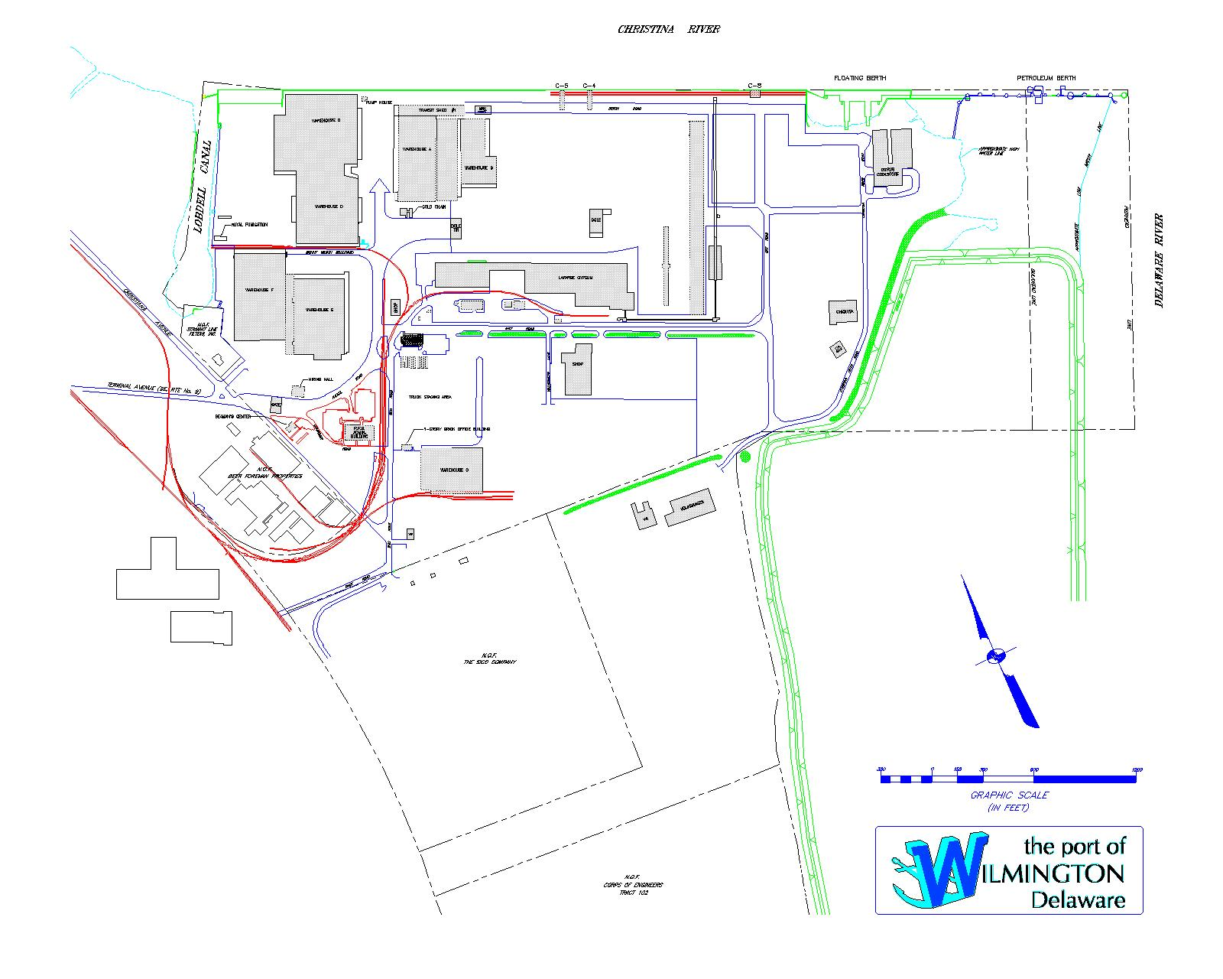
EXISTING CONDITIONS

